Slide 1
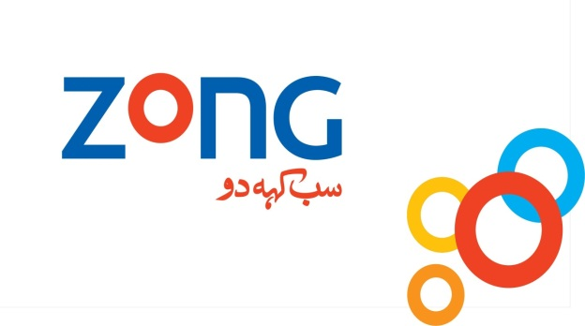
Case Study: Paktel to Zong
Presented To:
Moneeba Iftekhar
Presented By:
Shahrukh

Slide 2
Paktel
Paktel was the pioneer cellular operator of Pakistan.
It was the first ever company granted license to carry out cellular phone services in Pakistan, set up by Cable & Wireless.
It carried out AMPS (Analog Mobile Phone System) services until 2004 when the company switched to GSM technology.

Slide 3
history
Cable & Wireless launched commercial service Paktel in 1990.
It was first mediation software in the region which was developed locally and also the first cellular Billing System ever.
In November 2000, Millicom acquired 98.9% equity interest in Paktel. In April 2001, Paktel launched prepaid services under the brand Tango.
In October 2002, Paktel was granted a modification to its license, allowing it to operate a GSM based network.
Paktel was awarded additional 1800 MHz spectrum, increasing total spectrum for GSM network from 10 MHz to 13.6 MHz

Slide 4
Cont.…
After obtaining frequencies Paktel launched GSM network in October 2004.
By the November of 2005, Paktel had 1 million customer base and a market share of 9%
In November 2006, Millicom announced that it had decided to exit the Pakistani market.
Initially the Kuwait based company showed interest for buy-out. But it was the China Mobile who won the bid.

Slide 5
Marketing
Paktel offered prepaid and postpaid plans.
It was initially offering only postpaid services with PKR 5000 as initial security deposit.
The call rate was charged to both the caller and the receiver alike.
Paktel had customer service centers in major cities and country-wide network of franchises.
Paktel introduced the country's first offer of its kind – free credit on receiving incoming calls per minute basis. It came up with the slogan Call Suno Balance Barhao; Baqi Sab Bhool Jao.
As of 2007, Paktel was ranked fifth mobile player of Pakistani market owing to low subscriber base and market share.

Slide 6
SWOT Analysis of Paktel
Strengths
First mobile company in Pakistan, Paktel had an enormous branding leverage.
The main strength that they have prestige to its customers. It’s a totally customer focused organization.
Paktel has a very qualified base of employee who is skilled in their areas of work and have proved their competence.
The company has targeted the class of customers that was previously being neglected by other cellular operators. Therefore it has been able to develop a niche of low-income mobile phone users.
Paktel has the largest network than any other company has in Pakistan.

Slide 7
Weaknesses
Well-established in GSM technology, competitors already exist in the industry.
As the company is new in GSM technology, it has yet made large investments. It will take some time before it starts generating profits.
Paktel is not spending too much on advertisement.
Paktel has to go through the stages that these companies have already completed.

Slide 8
Opportunities
Improvement in technology has enabled PAKTEL to provide quality services.
Consumers attitude towards the mobile services have a positive impact on the company, as they demand quality services from PAKTEL inextricable part of the branding process. It renders the some natural advantage of scoring more runs in a career.
The target market has vast potential.
The target market is largely untapped. There are very few competitors, in reality only two i.e. Mobilink and U-fone
PAKTEL can enter areas in which there is little or no development and become a leader through providing innovation and entering these areas before its competitors.
PAKTEL has the opportunity of being able to capture potential customers who have not been targeted as yet by its competitors.

Slide 9
Threats
The biggest threat that PAKTEL faces is that the PTCL monopoly will be broken in 2005. This will result in new competitors entering the telecommunication industry accompanied by new competitors in the cellular industry of Pakistan.
There are several Govt. regulations and laws that the company has to consider and abide by, which sometimes may lead to delays and inconvenience.
There are competitors that are already established in GSM technology.

Slide 10
Services
International SMS
Conference Calling
Call Waiting / Call holding
Voice Mailing
Call Forwarding
Caller line Identification

Slide 11
Marketing mix of Paktel and its flaws
Product
Postpaid packages
Prepaid packages
Other services and offers
Price
Pricing strategy of Paktel was profit oriented, suitable when no or low competition.
Paktel should have adopted sales oriented strategy to increase its sales volume.

Slide 12
Cont.
Promotion
A promotional strategy was not effective as it failed to communicate their intended information.
Place
Few franchise.
Channel of distribution was not organized and effective.

Slide 13
Causes of failure
Consumers were facing enormous difficulties due to network of Pakistan which had failed to come to the expectations of the users.
Paktel was failed to provide any kind of facility to its consumers despite of all promises and claims.
The helpline facility was not much available which used to frustrate the customer.
Extra emphasis on few packages and no more new innovation.
Paktel GSM adopted, near about all possible ways to re-alive company (even by adding China Telecom) but failed.

Slide 14
Cont.
PTA (Pakistan Telecommunication Authority) was concerned about that they don’t care if Paktel closes down but Paktel has to pay the $29m before they exit.
Paktel Company is small with a capacity of only 2 million subscribers. Some times Paktel subscribers face problems in receiving calls and SMS sometimes didn’t reach.
With no GPRS no MMS Paktel is only for small group of people.
Increased competition lead to further difficulties in establishing their brand name.
Brand equity could not be developed properly.
Increased and rapid innovation by competitors.
People regarded it as a low quality last option product.

Slide 15
Paktel was rebranded to Zong
On January 22, 2007, Millicom International stated that it would sell its 88.86% stake in Paktel to China Mobile for $284 million, which includes the repayment of intercompany debt.
On 4 May 2007, Paktel Limited was renamed to China Mobile Pakistan. On May 16, 2007 China Mobile announced that it had increased its stake in CMPak to 100%.
China Mobile Pakistan continued to operator under Paktel brand until March 31, 2007.
PTA said that it might resolve the frequency issue with China Mobile, as it was one of the main reason for pullout by Millicom International.
According to the statistics from the PTA, Paktel had 2.145 million customers at the end of February 2008.
On April 1, 2008, Paktel was rebranded to Zong. CMPak organized a launch event on April 5.

Slide 16
China Mobile Pakistan (CMPak) or Paktel Limited
CMPak or Paktel Limited formed in 1990 is a 100% subsidiary of China Mobile.
The pioneering oversea setup of China Mobile came through acquisition from a license from Millicom to operate a GSM network in Pakistan, granted license to carry out cellular phone services in Pakistan, set up by Cable & Wireless.
It is determined to make its mark in the Pakistani market and to change the way people communicate. It markets its products under the brand name "ZONG”.
Currently, 4G coverage extends to over 100 cities of Pakistan and this number is increasing day by day.
CMPak has the highest number of 4G sites in the highest number of cities which testifies their commitment to provide a stable, affordable and reliable network to the customers.

Slide 17
ZONG
Vision
Become an indispensable (absolutely necessary) digital life partner.
Mission
To lead the future innovatively through:
Customer Centricity (central importance)
Boundary less Team

Slide 18
Product and services
Prepaid Packages
ZONG 65
12 Aanay package
50 paisa/ call (8 Aanay)
ZONG super free number
Break time offer
Aik second package
Unlimited SMS package

Slide 19
Cont.
Postpaid Packages
Line Rent (Rs) | 100 | 300 | 600 | 1200 | 2000
On-Net Calls Airtime | 0.5 | 0.45 | 0.375 | 0.3 | 0.1
Off-Net Calls Airtime | 0.5 | 0.45 | 0.375 | 0.3 | 0.2
FNF | 0.4 | 0.3 | 0.2 | NA | N/A
Spouse Number | N/A | N/A | N/A | Free | N/A
Free SMS (On & Off-Net) | 20 | 60 | 100 | 150 | 300
SMS Rate | 1 | 1 | 1 | 1 | 1
GPRS | 15 | 15 | 15 | 15 | 15
Free Minutes Break Up | 100 | 300 | 600 | 1,200 | 6,800
On-Net | 60 | 180 | 360 | 720 | 6,000
Off-Net-PTCL | 20 | 60 | 120 | 240 | 400
Off-Net-Other Mobile Operator | 20 | 60 | 120 | 240 | 400
Refundable Security Deposit | 600 | 1000 | 1500 | 2500 | 4000
Interconnect Charges | Other Mobile Operators | PTCL
Per/ min | 1 | 0.52
Per /30 Sec | 0.5 | 0.26

Slide 20
Cont.
ZONG Mobile Internet
ZONG unlimited
ZONG Free
ZONG internet USB
Zong Daily Mini 3G, 4G Package
Zong Daily Basic 3G, 4G Package
Zong Daily Premium 3G, 4G Package
Zong Weekly 3G Packages – Zong Weekly 4G LTE Package
Zong Monthly 3G Packages – Zong Monthly 4G LTE Packages:
Zong Monthly Premium 1-GB 3G, 4G Package
ZONG Internet Sim

Slide 21
Marketing mix
Product
ZONG offers:
Postpaid packages
Prepaid packages
Other Services and Offers
Price
ZONG is using price penetration because all the packages (postpaid and prepaid) are very low priced and other value added services are also very low in cost. Some of them are free of cost like:
Missed call alert
Conference call
Subscription of SMS packages

Slide 22
Cont.
Promotion
ZONG is promoting its products and services in many ways like:
Print media
Billboards
TV ads
Mobile promotions
Internet

Slide 23
Cont.
Place
ZONG is reaching to its customers in the following manners:
Franchises
Customer service centers
Retailers
Through Student Entrepreneurs

Slide 24
Business structure
Marketing
Zong campaign has taken a fresh, bold and humorous approach to marketing.
Its advertisements reveal both the culture of country and feelings of customers.
Within each area the sales and marketing force are divided among various customer groups to meet their specific needs.
Telecom
Zong has implemented GSM and EDGE (Enhanced Data rates for GSM Evolution) technologies to provide data transmission technology for high-speed transfer of large amount of information (voice & data services) across mobile networks.

Slide 25
Swot analysis
Strengths
All the products and services of ZONG are easily available in outlets or customer care center.
Motivated, educated and qualified staff makes services more reliable and satisfy customers.
ZONG is at more competitive on experience curve.
Weaknesses
Number of customer care center is not sufficient, customer some time should have to wait a bit.
The staff of CSC (next generation IT infrastructure services) is not involved in more outdoor activities.
Coverage issues in some cities decrease the customers’ interest in purchasing the connection.

Slide 26
Cont.
Opportunities
Sales can be increased if more and more outdoor activities can be done by the management.
China mobile have large experience of network so ZONG can introduce new products such as dish TV because ZONG have good wireless technology.
Threats
Competitors are the biggest threat for any company. Here also exist Warid, Mobilink, Ufone and Telenor
According to PTA36 rules any one can switch to other mobile network that they think are reliable and due to signal problem and call drop complains in some hilly areas.
Attractive packages by competitors.

Slide 27
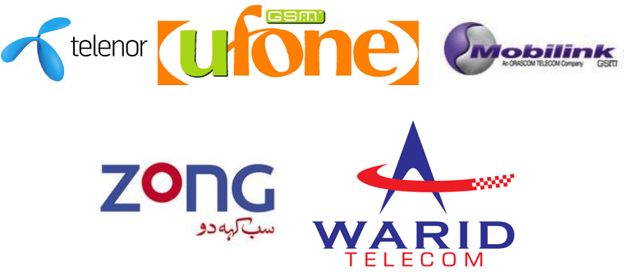
competitors
Mobilink
Ufone
Warid
Telenor

Slide 28
Recommendations
Zong should be increasing their network coverage and foot prints in every corner of the country to capture the market.
Zong should adopt the strategies of market penetration market development and related diversification, but the most effective strategy would be market penetration.
Zong should hire the skilled management.
Zong should not waste their opportunities and get more help as possible.
Give quality service, try to co-brand with famous IT based company like Microsoft.
In future, company has to collaborate with banks in order to customer refill their credits and pay their bills.
The company can go for Kiosk marketing at places like airports, shopping malls and centers. This marketing technique will promote brand image.

Slide 29
THANK YOU….!

